Slide 1
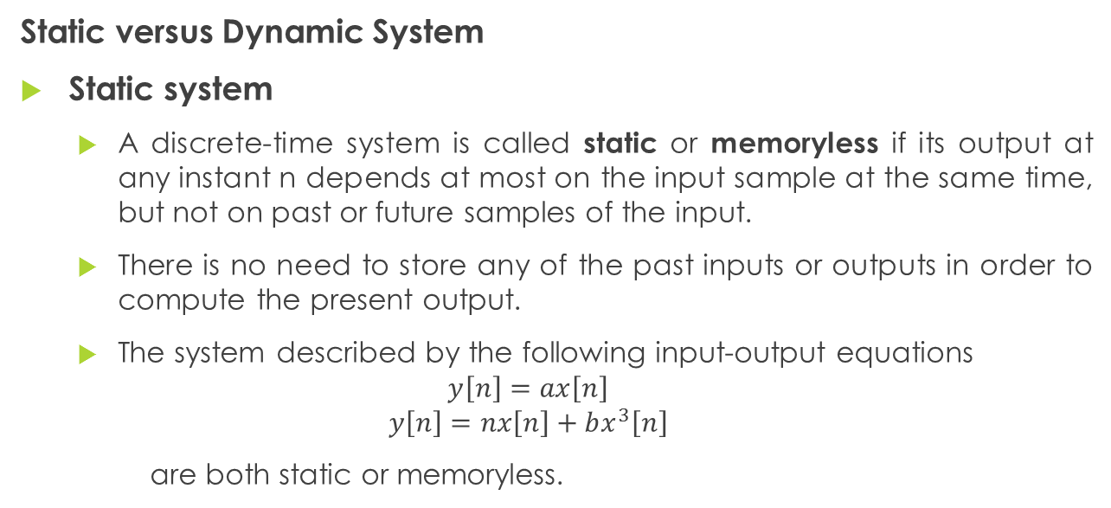
Classification of Discrete-Time Systems
Static versus Dynamic System
Static system
A discrete-time system is called static or memoryless if its output at any instant n depends at most on the input sample at the same time, but not on past or future samples of the input.
There is no need to store any of the past inputs or outputs in order to compute the present output.
The system described by the following input-output equations
$$y\left[n\right]=ax\left[n\right]$$
$$y\left[n\right]=nx\left[n\right]+bx^{3}\left[n\right]$$
are both static or memoryless.

Slide 2
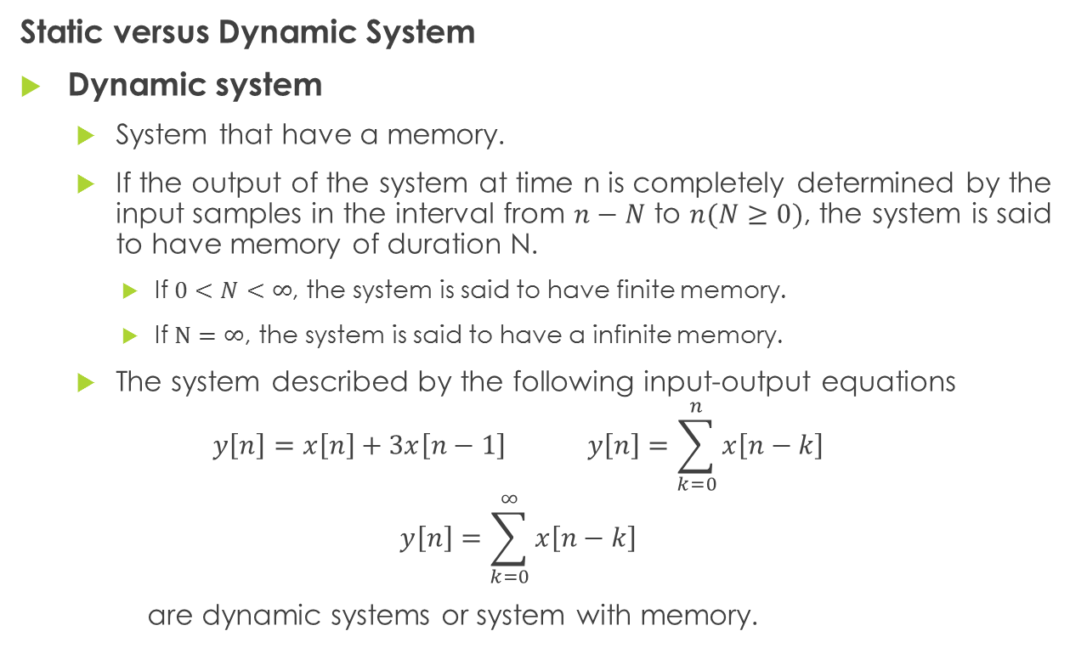
Classification of Discrete-Time Systems
Static versus Dynamic System
Dynamic system
System that have a memory.
If the output of the system at time n is completely determined by the input samples in the interval from $n−N$ to $n(N≥0)$, the system is said to have memory of duration N.
If $0<N<∞$, the system is said to have finite memory.
If $N=∞$, the system is said to have a infinite memory.
The system described by the following input-output equations
$$y\left[n\right]=x\left[n\right]+3x\left[n−1\right] y\left[n\right]=\sum_{k=0}^{n}{x\left[n−k\right]}$$
$$y\left[n\right]=\sum_{k=0}^{∞}{x\left[n−k\right]}$$
are dynamic systems or system with memory.

Slide 3
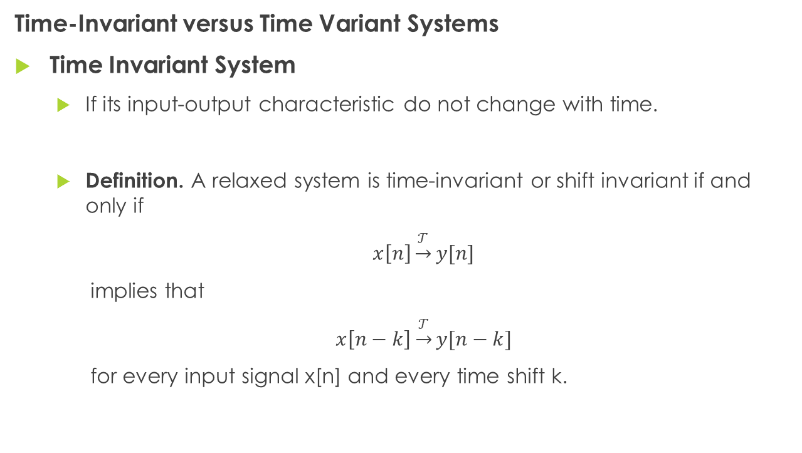
Classification of Discrete-Time Systems
Time-Invariant versus Time Variant Systems
Time Invariant System
If its input-output characteristic do not change with time.
Definition. A relaxed system is time-invariant or shift invariant if and only if
$x\left[n\right]\underset{→}{𝒯}y[n]$
implies that
$x\left[n−k\right]\underset{→}{𝒯}y[n−k]$
for every input signal x[n] and every time shift k.

Slide 4
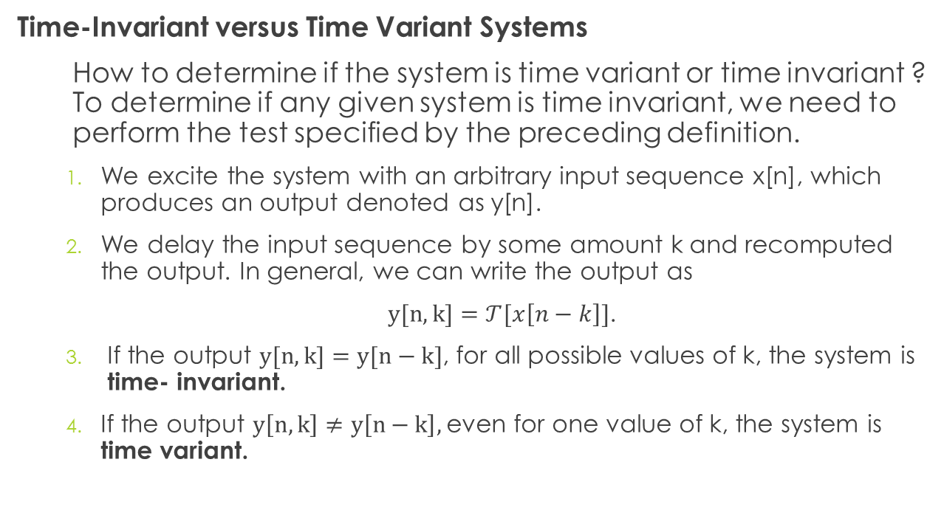
Classification of Discrete-Time Systems
Time-Invariant versus Time Variant Systems
How to determine if the system is time variant or time invariant ? To determine if any given system is time invariant, we need to perform the test specified by the preceding definition.
We excite the system with an arbitrary input sequence x[n], which produces an output denoted as y[n].
We delay the input sequence by some amount k and recomputed the output. In general, we can write the output as
$y[n,k]=𝒯[x\left[n−k\right]]$.
If the output $y[n,k]=y[n−k]$, for all possible values of k, the system is time- invariant.
If the output $y\left[n,k\right]≠y\left[n−k\right],$even for one value of k, the system is time variant.

Slide 5
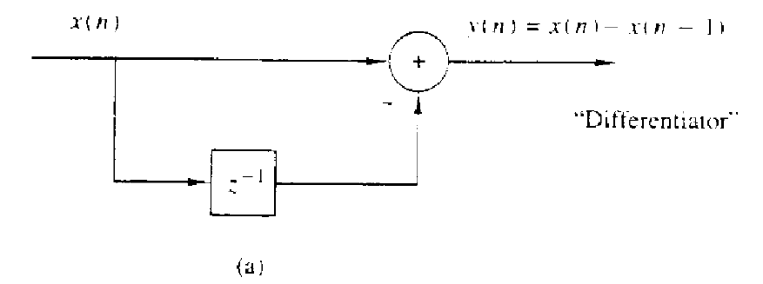
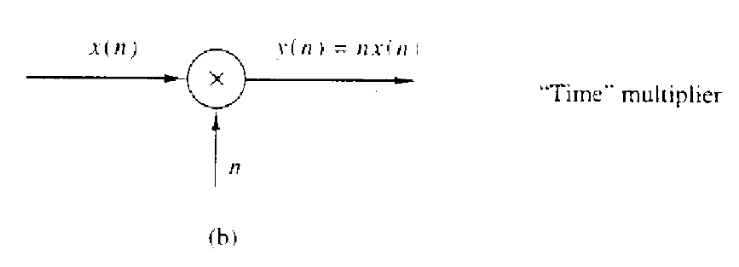
Classification of Discrete-Time Systems
Time-Invariant versus Time Variant Systems
Example: Determine if the system shown below are time invariant or time variant.

Slide 6
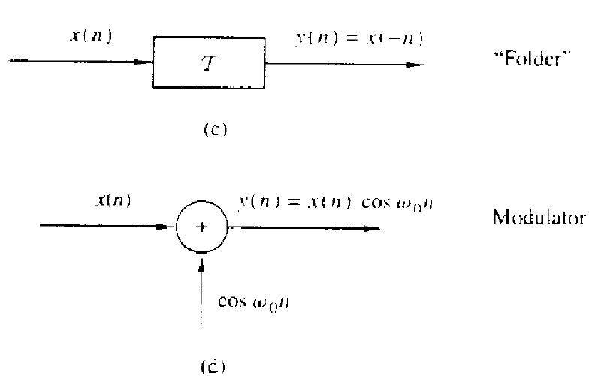
Classification of Discrete-Time Systems
Time-Invariant versus Time Variant Systems
Example: Determine if the system shown below are time invariant or time variant.

Slide 7
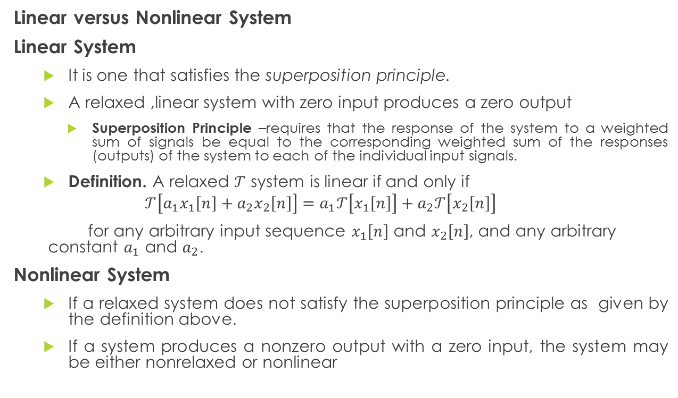
Classification of Discrete-Time Systems
Linear versus Nonlinear System
Linear System
It is one that satisfies the superposition principle.
A relaxed ,linear system with zero input produces a zero output
Superposition Principle –requires that the response of the system to a weighted sum of signals be equal to the corresponding weighted sum of the responses (outputs) of the system to each of the individual input signals.
Definition. A relaxed $𝒯$ system is linear if and only if
$$𝒯\left[a_{1}x_{1}\left[n\right]+a_{2}x_{2}\left[n\right]\right]=a_{1}𝒯\left[x_{1}\left[n\right]\right]+a_{2}𝒯\left[x_{2}\left[n\right]\right]$$
for any arbitrary input sequence $x_{1}\left[n\right]$ and $x_{2}\left[n\right]$, and any arbitrary constant $a_{1}$ and $a_{2}$.
Nonlinear System
If a relaxed system does not satisfy the superposition principle as given by the definition above.
If a system produces a nonzero output with a zero input, the system may be either nonrelaxed or nonlinear

Slide 8
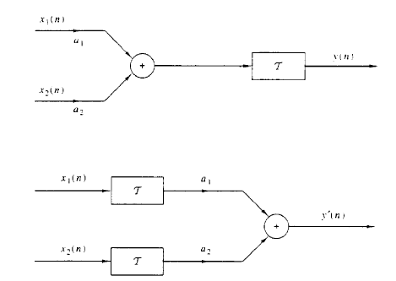

Classification of Discrete-Time Systems
Linear versus Nonlinear System
$𝒯$is linear if and only if $y\left[n\right]=y^{′}\left[n\right]$
Graphical representation of the superposition principle.

Slide 9
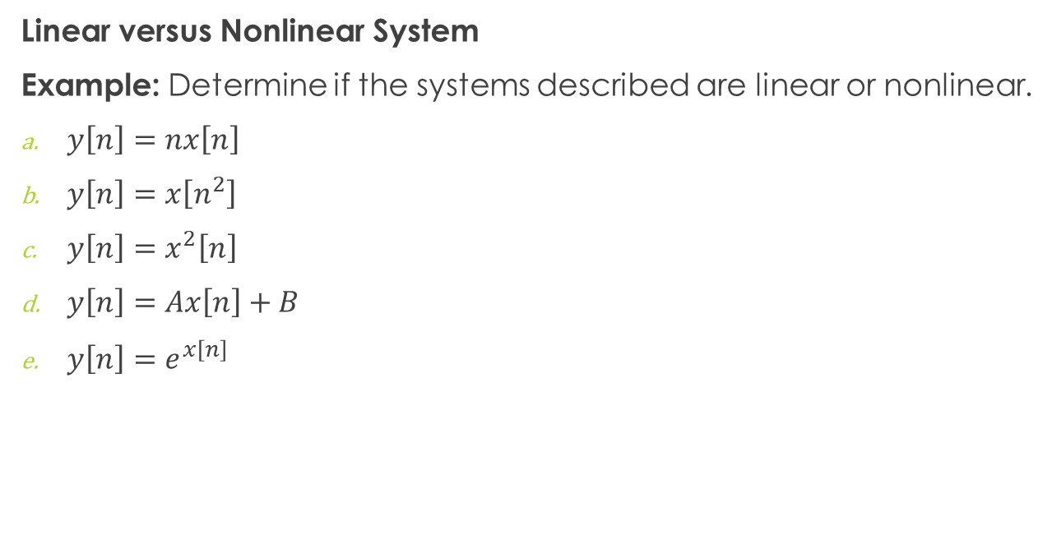
Classification of Discrete-Time Systems
Linear versus Nonlinear System
Example: Determine if the systems described are linear or nonlinear.
$y\left[n\right]=nx\left[n\right]$
$y\left[n\right]=x\left[n^{2}\right]$
$y\left[n\right]=x^{2}\left[n\right]$
$y\left[n\right]=Ax\left[n\right]+B$
$y\left[n\right]=e^{x\left[n\right]}$

Slide 10
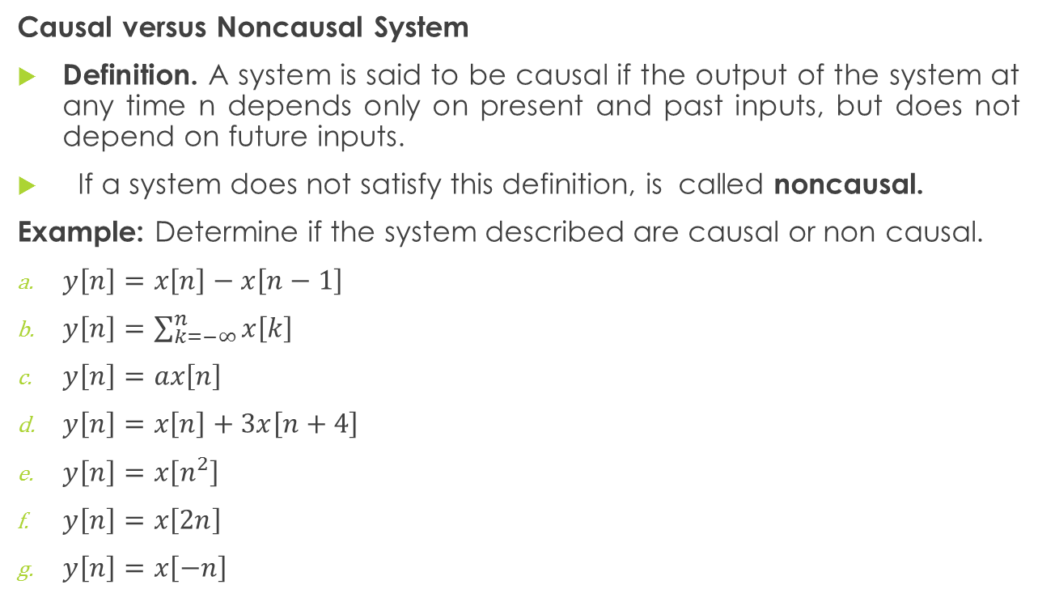
Classification of Discrete-Time Systems
Causal versus Noncausal System
Definition. A system is said to be causal if the output of the system at any time n depends only on present and past inputs, but does not depend on future inputs.
If a system does not satisfy this definition, is called noncausal.
Example: Determine if the system described are causal or non causal.
$y\left[n\right]=x\left[n\right]−x\left[n−1\right]$
$y\left[n\right]=\sum_{k=−∞}^{n}{x\left[k\right]}$
$y\left[n\right]=ax\left[n\right]$
$y\left[n\right]=x\left[n\right]+3x\left[n+4\right]$
$y\left[n\right]=x\left[n^{2}\right]$
$y\left[n\right]=x\left[2n\right]$
$y\left[n\right]=x\left[−n\right]$

Slide 11
Classification of Discrete-Time Systems
Stable versus unstable systems
Stability is an important property that must be considered in any practical application of a system . Unstable systems usually exhibit erratic and extreme behavior and cause overflow in any practical implementation.
Definition. An arbitrary relaxed system is said to be bounded input-bounded output (BIBO) stable if and only if every bounded input produces a bounded output.
Notes:
In the analysis as wa

Slide 12

Classification of Discrete-Time Systems
Example: Determine if the system described are stable or unstable.
$y\left[n\right]=x^{2}[n]$
$y\left[n\right]=nx\left[n\right]$
$y\left[n\right]=cosn.x\left[n\right]$
$y\left[n\right]=\frac{x[n]}{\sin{n}}$
Notes:
In the analysis as wa

Slide 13
Discrete Fourier Transform
-mathematical algorithm that can be computed efficiently on digital computers and other DSP Boards.
- an extension of CTFT for the time limited sequences with an additional restriction that the frequency is discretized at a finite set of values.

Slide 14
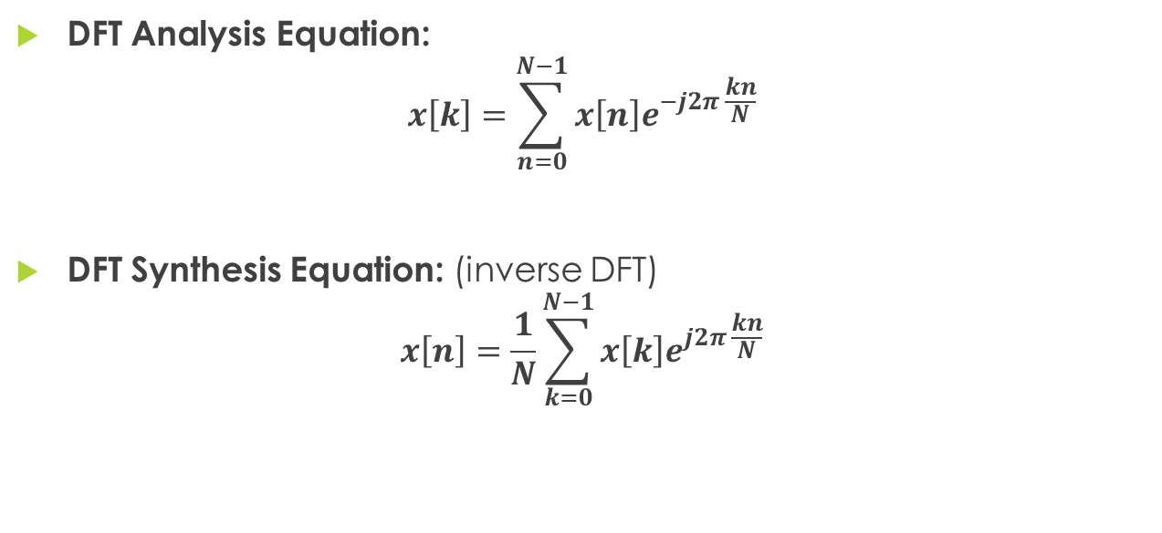
Discrete Fourier Transform
DFT Analysis Equation:
$$x\left[k\right]=\sum_{n=0}^{N−1}{x\left[n\right]e^{−j2π \frac{kn}{N}}}$$
DFT Synthesis Equation: (inverse DFT)
$$x\left[n\right]=\frac{1}{N}\sum_{k=0}^{N−1}{x\left[k\right]e^{j2π \frac{kn}{N}}}$$

Slide 15
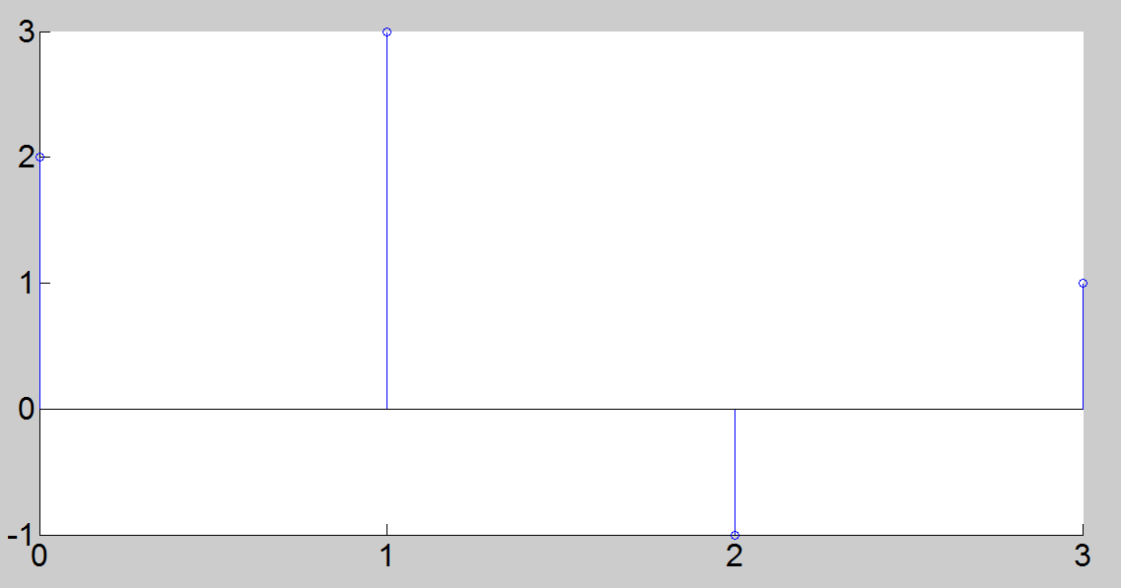

Example
1. Calculate the four-point DFT of aperiodic sequence $x[k]$ of length N = 4 which is defined by:

Slide 16
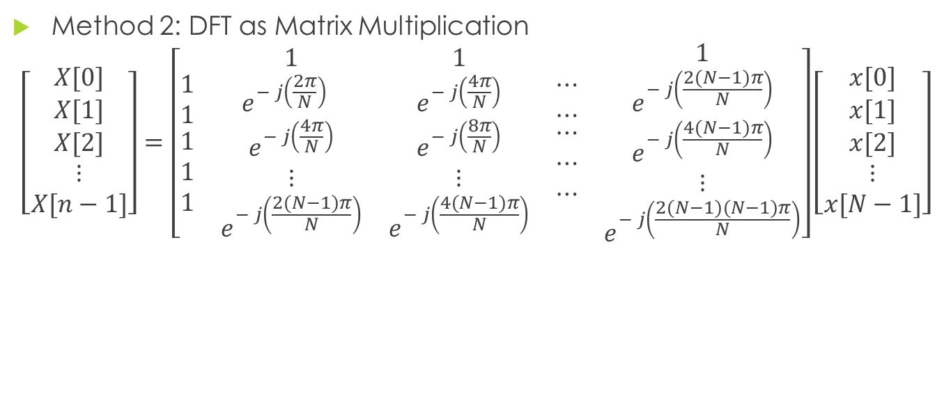
Discrete Fourier transform
Method 2: DFT as Matrix Multiplication
$$\left[\begin{matrix}X[0] \\ X[1] \\ \begin{matrix}X[2] \\ ⋮ \\ X[n−1]\end{matrix}\end{matrix}\right]=\left[\begin{matrix}\begin{matrix}1 \\ 1 \\ \begin{matrix}1 \\ 1 \\ 1\end{matrix}\end{matrix} & \begin{matrix}1 \\ e^{− j\left(\frac{2π}{N}\right)} \\ \begin{matrix}e^{− j\left(\frac{4π}{N}\right)} \\ ⋮ \\ e^{− j\left(\frac{2(N−1)π}{N}\right)}\end{matrix}\end{matrix} & \begin{matrix}\begin{matrix}1 \\ e^{− j\left(\frac{4π}{N}\right)} \\ \begin{matrix}e^{− j\left(\frac{8π}{N}\right)} \\ ⋮ \\ e^{− j\left(\frac{4(N−1)π}{N}\right)}\end{matrix}\end{matrix} & \begin{matrix}⋯ \\ ⋯ \\ \begin{matrix}⋯ \\ ⋯ \\ ⋯\end{matrix}\end{matrix} & \begin{matrix}1 \\ e^{− j\left(\frac{2(N−1)π}{N}\right)} \\ \begin{matrix}e^{− j\left(\frac{4(N−1)π}{N}\right)} \\ ⋮ \\ e^{− j\left(\frac{2(N−1)(N−1)π}{N}\right)}\end{matrix}\end{matrix}\end{matrix}\end{matrix}\right]\left[\begin{matrix}x[0] \\ x[1] \\ \begin{matrix}x[2] \\ ⋮ \\ x[N−1]\end{matrix}\end{matrix}\right]$$

Slide 17
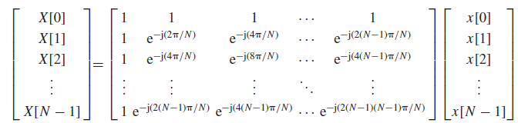
MATRIX MANIPULATION

Slide 18
Discrete Fourier transform
Solve the previous problem using Matrix multiplication:

Slide 19

Inverse Discrete Fourier Transform
Calculate the inverse DFT of
$x\left[k\right]=\left\{\begin{aligned}6 \\ −2+j2 \\ −2 \\ \#−2−j2 \#\end{aligned}\begin{matrix}n=0 \\ n=1 \\ \begin{aligned}n=2 \\ n=3\end{aligned}\end{matrix}\right.$

Slide 20
FOURIER SERIES
A Fourier series is an expansion of a periodic function f(x) in terms of an infinite sum of sines and cosines.
Fourier series make use of the orthogonality relationships of the sine and cosine functions.
The computation and study of Fourier series is known as harmonic analysis and is extremely useful to break up an arbitrary periodic function into a set of simple terms that can be plugged in, solved individually, and then recombined to obtain the solution to the original problem or an approximation to it to whatever accuracy is desired or practical.

Slide 21
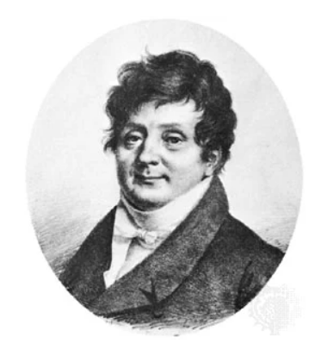
FOURIER SERIES
Joseph Fourier, in full Jean-Baptiste-Joseph, Baron Fourier, (born March 21, 1768, Auxerre, France—died May 16, 1830, Paris)

Slide 22
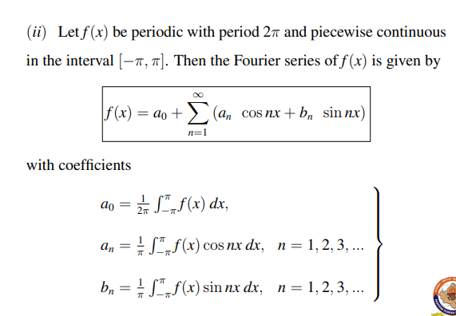

Fourier series with period 2$π$

Slide 23
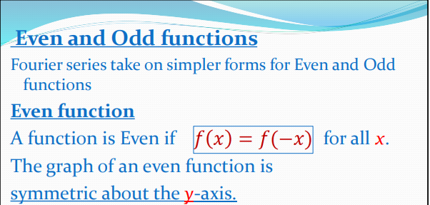
Fourier Series

Slide 24
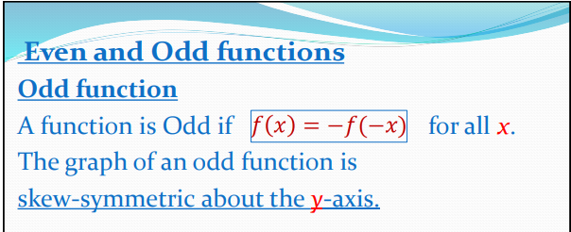
Fourier Series

Slide 25

EXAMPLE NO. 1
Let f(x) be a function of period 2 such that
f(x)$= \frac{x}{2} \left[0, 2π\right].$
Find the Fourier series of f(x) over [0, 2]

Slide 26

EXAMPLE NO. 2
Find the Fourier series of
$$f\left(x\right)=\left\{\begin{aligned}1, −\frac{π}{2}<x<\frac{π}{2} \\ −1 ,\frac{π}{2}<x<\frac{3π}{2}\end{aligned}\right.$$

Slide 27
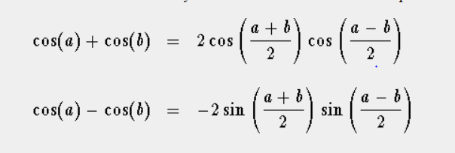
Trigonometric Identity

Slide 28



PRODUCT OF SINES AND COSINES
$$\int{sinu sinv dv}$$
$$\int{cosu cosv dv}$$
$$\int{sinu cosv dv}$$
$$u≠v$$
Use these trigonometric identities
$$2sinu\cos{v=\sin\left(u+v\right)+\sin\left(u−v\right)}$$
$$2sinu\sin{v=\cos\left(u−v\right)−\cos\left(u+v\right)}$$
$$2cosu\cos{v=\cos\left(u+v\right)+\cos\left(u−v\right)}$$

Slide 29
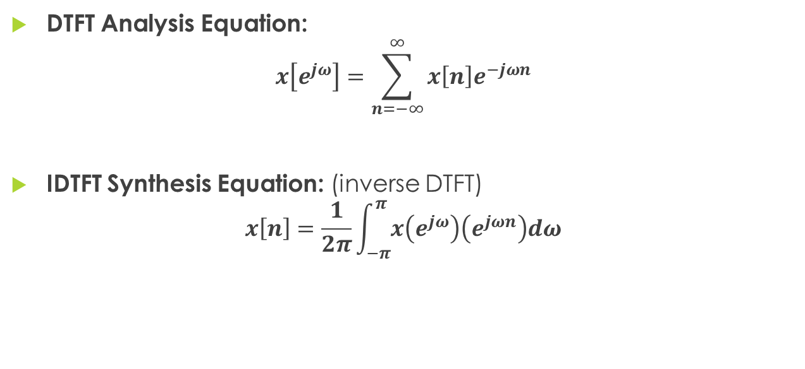
Discrete Time Fourier Transform (DTFT)
DTFT Analysis Equation:
$$x\left[e^{jω}\right]=\sum_{n=−∞}^{∞}{x\left[n\right]e^{−jωn}}$$
IDTFT Synthesis Equation: (inverse DTFT)
$$x\left[n\right]=\frac{1}{2π}\int_{−π}^{π}{x\left(e^{jω}\right)\left(e^{jωn}\right)dω}$$

Slide 30

IDTFT Properties
$$δ^{n}=1$$
$$δ\left(n−1\right)=e^{−jω}.1$$
$$δ\left(n−2\right)=e^{−j2ω}.1$$
$$δ\left(n+2\right)=e^{j2ω}.1$$

Slide 31

Examples - DTFT
$x(n)=α^{n}u\left(n\right) ;α<1$
$x\left(n\right)=2^{n}u\left(−n\right)$
$x(n)=({\frac{1}{3})}^{n}u\left(n−3\right)$
$x\left(n\right)=δ\left[n\right]$

Slide 32
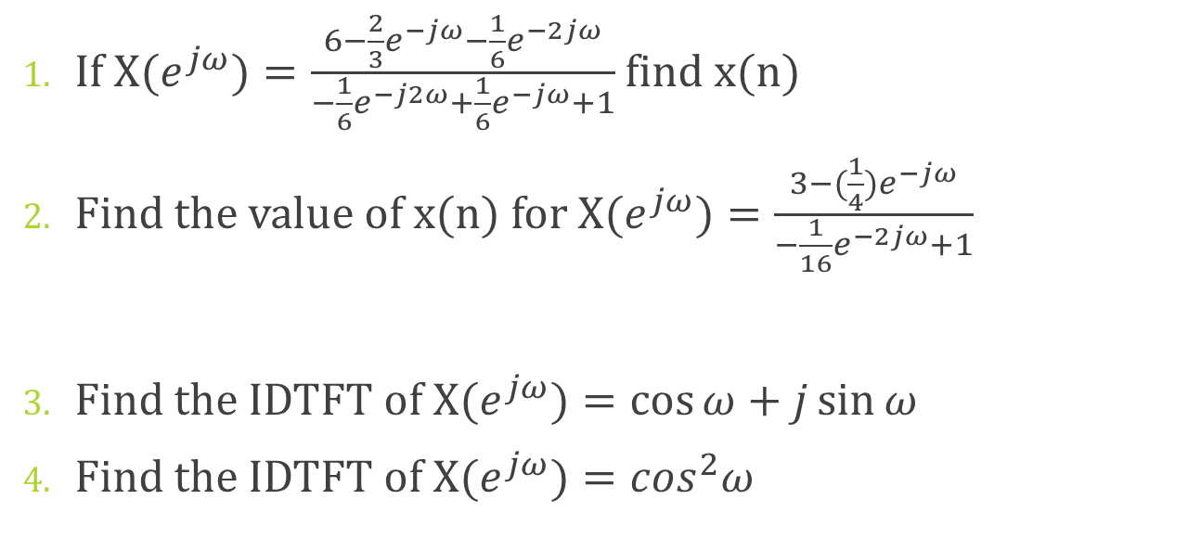
Examples - IDTFT
If $X(e^{jω})=\frac{6−\frac{2}{3}e^{−jω}−\frac{1}{6}e^{−2jω}}{−\frac{1}{6}e^{−j2ω}+\frac{1}{6}e^{−jω}+1}$ find x(n)
Find the value of x(n) for $X(e^{jω})=\frac{3−(\frac{1}{4})e^{−jω}}{−\frac{1}{16}e^{−2jω}+1}$
Find the IDTFT of $X(e^{jω})=\cos{ω+j\sin{ω}}$
Find the IDTFT of $X(e^{jω})=\cos^{2}ω$

Slide 33
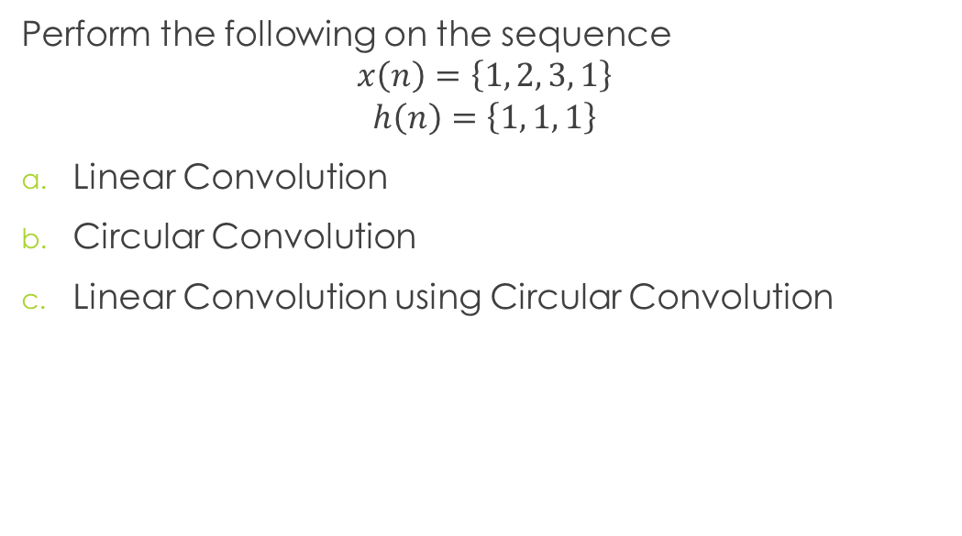
CONVOLUTION
Perform the following on the sequence
$$x\left(n\right)=\left\{1, 2, 3, 1\right\}$$
$$h\left(n\right)=\left\{1, 1, 1\right\}$$
Linear Convolution
Circular Convolution
Linear Convolution using Circular Convolution

Slide 34

CONVOLUTION
Determine the linear convolution of the following system signals
$$x\left(n\right)=δ\left(n\right)+3δ\left(n−1\right)+2δ\left(n−1\right)−δ\left(n−3\right)+δ\left(n−4\right)$$
$$h\left(n\right)=2δ\left(n\right)−δ\left(n−1\right)$$

